Slide 1
Arch Dental Associates
Tesseract Software Designs
Adam Franzen
Logical Presentation

Slide 2
Background / History
Arch Dental is a general dentistry practice with two locations, and a host of office personnel, and providers (hygienists and doctors)
The business is owned and operated by multiple partners who oversee operations
Sights set on expansion
Needs a robust computing system to help manage their business
Years painstakingly maintaining a paper business
Rooms and providers are not being used efficiently
No accurate tracking of clinic services offered
No ability to make reports on business financial/activity history

Slide 3
Environment
Arch has multiple locations
Each location has several rooms/spaces that can be utilized for patient services
Patients are scheduled for appointments and are given an estimated time to complete requested procedures
Procedures may be completed by hygienists or doctors

Slide 4
Users / Roles
Client
Provider
Admin

Slide 5
Users / Roles
Client
Primary Account Holder
View/edit household account info
View/cancel Appointments
View/create Payments
Services
Designate primary insurance holder
Add/edit insurance
Add/edit dependents

Slide 6
Users / Roles
Office
An office worker or provider
Create/view/update individual client account info
Create/view/update appointments
Process payments
Generate reports

Slide 7
Users / Roles
Admin
Main partners/providers of practice
Create/view/edit any screen
Create/edit office staff and providers
Create/edit clinics
Create/edit rooms
Create/edit services
Create/edit qualifications
Create/edit allowed insurance

Slide 8
Functional Requirements
The system shall allow the Client to:
Access account information
Scheduling, Payments, History, Insurance, Dependents
Make payments
Cancel appointments

Slide 9
Functional Requirements
The system shall allow Office users to:
Create and edit client information
Create and edit appointments and payments
Generate reports

Slide 10
Functional Requirements
Admin
View/Update any screen
Create/Update office staff
Create/Update clinics, services, and staff qualifications

Slide 11
Non-functional Requirements
The system shall function via web browser – optimized for Chrome
The system shall utilize an Oracle database
The system shall leverage IIS and asp.NET 4.0

Slide 12
Features and Benefits
Feature | Benefit
Appointments accessible from any computer | No more confusing, disorganized, and out of date paper
Real world, up to date data | No more under/over booked providers/rooms
Clients can manage their account online | Lighter workload on employees, added convenience for clients

Slide 13
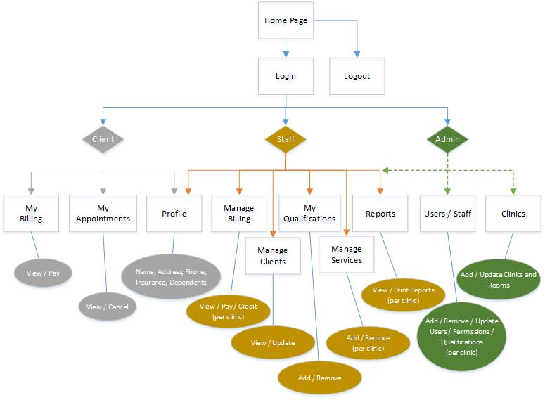
Site Diagram

Slide 14
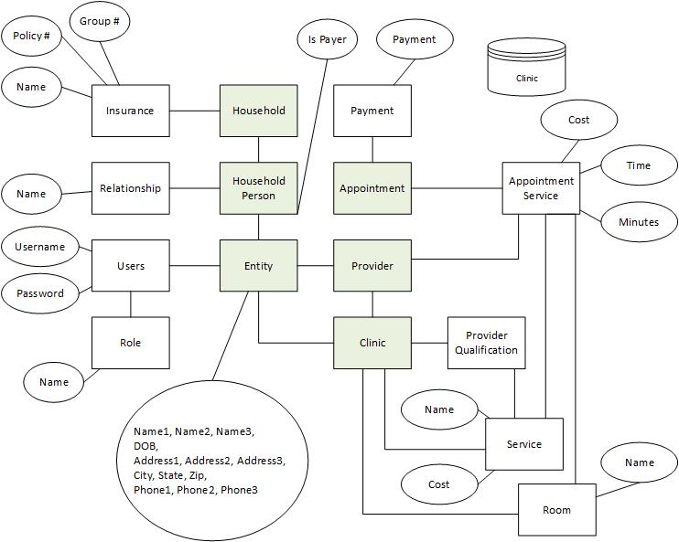
Database

Slide 15
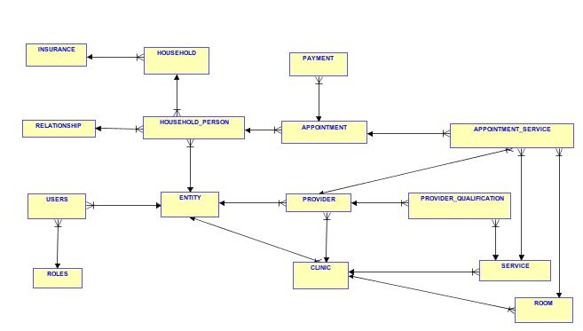
Database

Slide 16
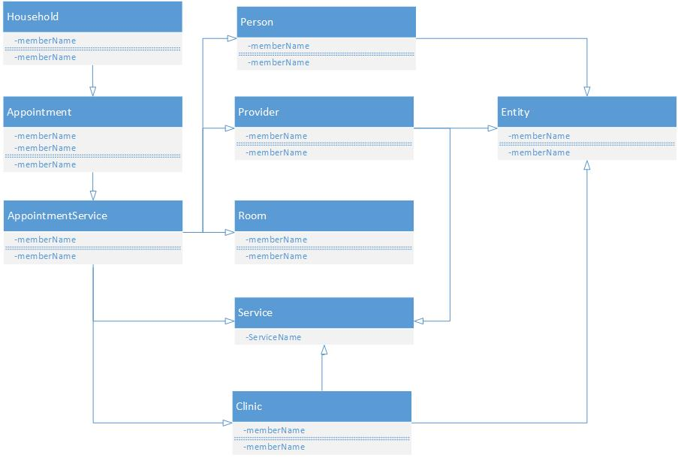
UML

Slide 17
Use Cases
Use Case Name: | Cancel Appointment
Actors: | Client
Scenario: | The user logs in and comes to the landing page and selects Appointments. Is presented with a list of appointments (likely only 1 or 2). Clicks the appointment of interest and is presented with all of the appointment details. The user then selects “Cancel Appointment”. A confirmation message shows. The user confirms.

Slide 18
Use Cases
USE CASE # | 1
Goal in Context | The user wants to cancel their appointment
Scope & Level | Primary Task
Preconditions | User is already registered and can login
Success End Condition | Appointment is cancelled
Failed End Condition | Appointment is not cancelled
Primary/Secondary Actors | Client
Trigger
DESCRIPTION | Step | Action
 | 1 | Go to landing page
 | 2 | Click Appointments
 | 3 | Select Appointment to cancel
 | 4 | Select “Cancel Appointment” Button
EXTENSIONS | Step | Branching Action
 | 1 | None
SUB-VARIATIONS | Step | Branching Action
 | 1 | None

Slide 19
Status – Last Week
Finalized database design (2.5 hours)
Research Entity Framework (4 hours)
Throwing out Entity Framework – Non-functional for .NET 4.0
Wrote requirements based upon initial requirements doc (1.5 hours)
Finalized Users/Roles (0.5 hours)
Finalized front-end framework (0.5 hours)
Single Page Application, Angular JS, Bootstrap-UI, Angular-UI, LESS, AJAX-JSON
Finalize back-end framework (0.5 hours)
Microsoft Web API
Layered approach (Controller / Business Layer / Data Layer)
Data Layer will utilize inline SQL

Slide 20
Status – This Week
Begin implementing features
Establish UI Framework and tooling
Establish back end framework layers and achieve Oracle connection
Landing Page
Logo
Login / Security
Navigation
Encryption / Decryption of passwords and Tax ID (Social Security Number)

Slide 21
Status – Challenges
Spent a lot of time struggling with Entity Framework
Couldn’t get it working despite many videos/tutorials showing it working
Research shows that Oracle doesn’t play nicely with .NET 4.0 and Entity Framework

